Slide 1

Word sense disambiguation

Slide 2
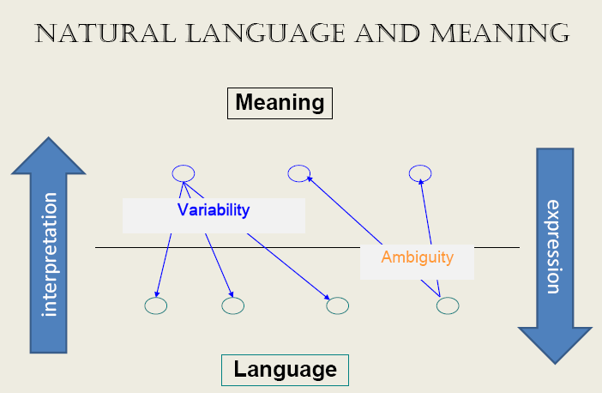
Ambiguity and variability of natural languages

Slide 3
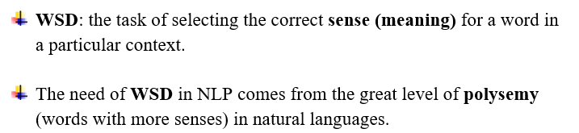
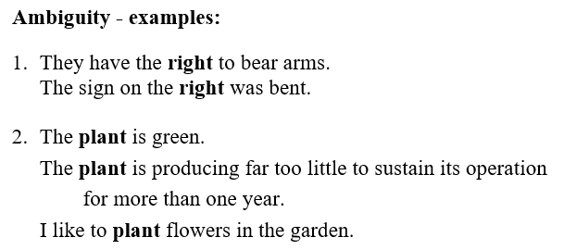

Word sense disambiguation (WSD)

Slide 4
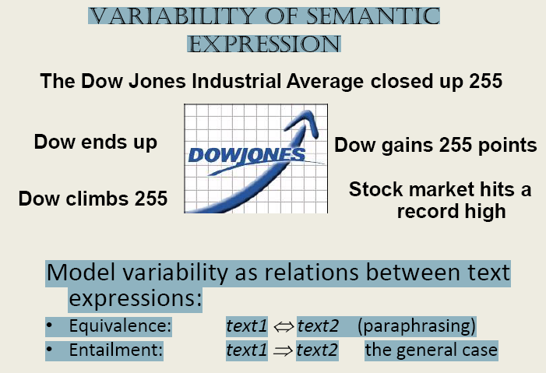
language variability problem - stating the same meaning in various ways
Textual entailment (TE): T entails H (T⇒H) if
humans reading T will infer that H is most likely true
or
the meaning of H can be inferred from the meaning of T
The paraphrasing problem is defined as a bidirectional entailment:
T1 is a paraphrase of T2 if T1⇒T2 and T2⇒T1.

Slide 5
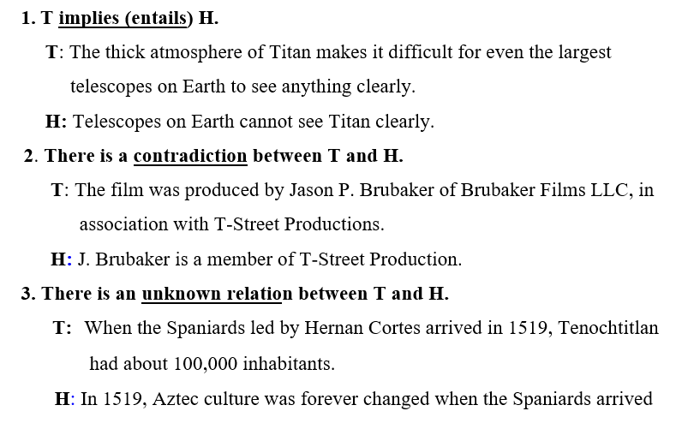
Textual Entailment: A 3-way task

Slide 6
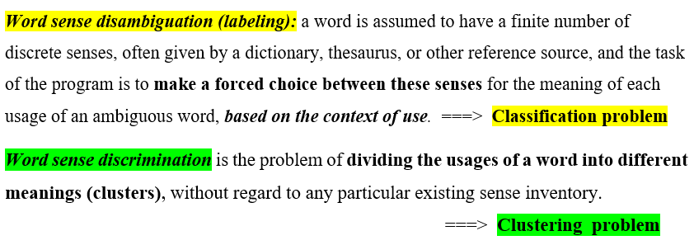
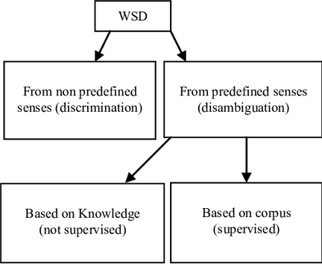
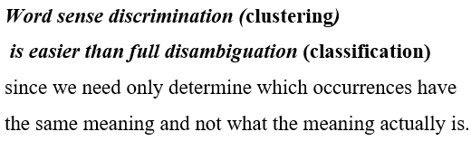

Slide 7
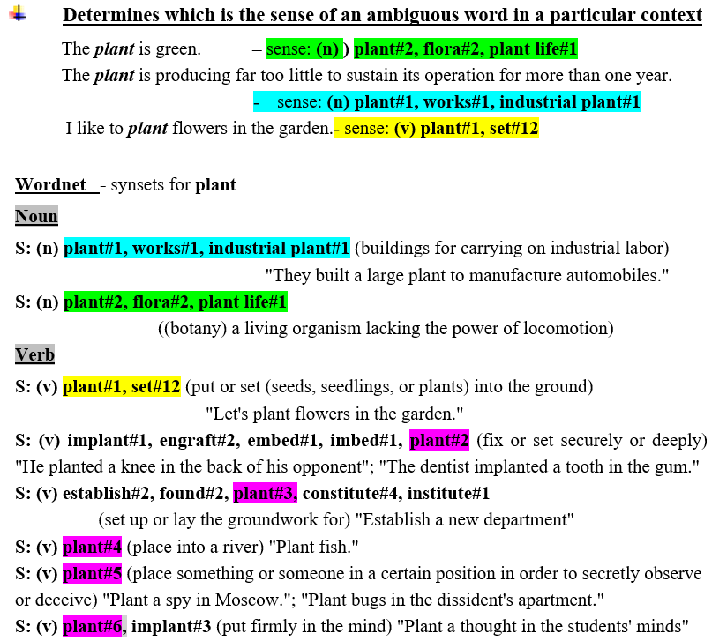
Word sense Disambiguation (Labeling)

Slide 8
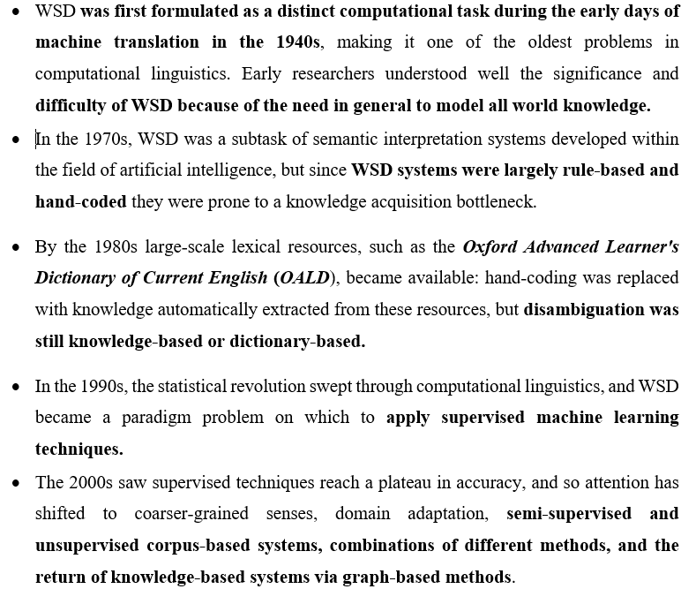
The history of WSD

Slide 9
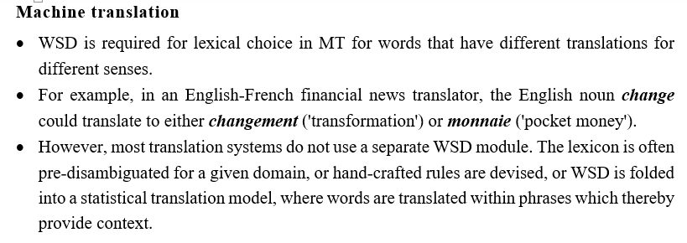
Applications of WSD

Slide 10
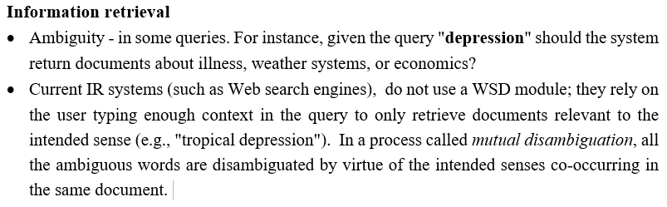
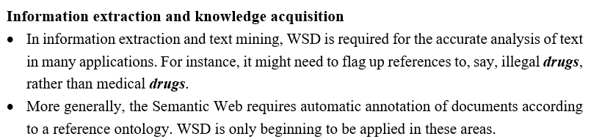
Applications of WSD

Slide 11
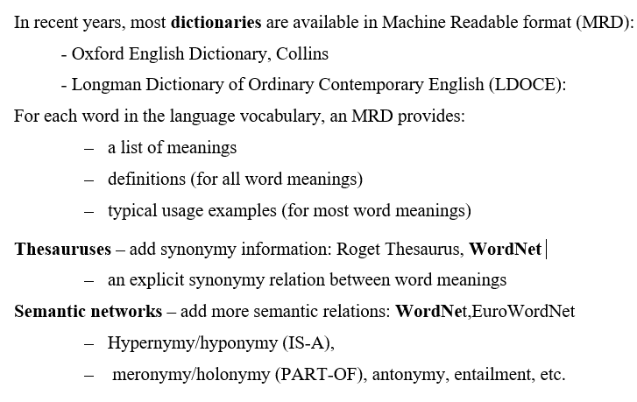
Resources

Slide 12
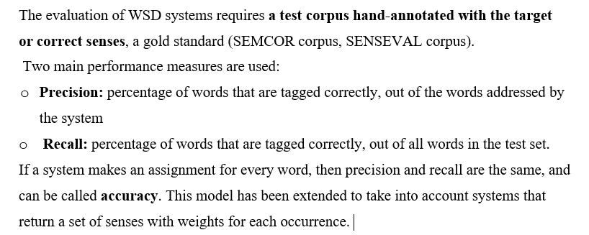
Evaluation of WSD systems

Slide 13
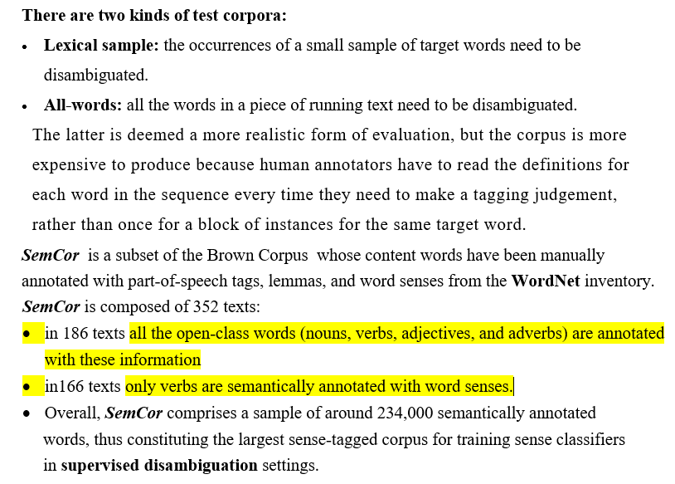

Slide 14
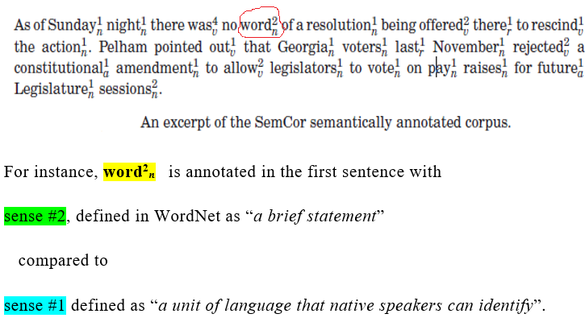
Example

Slide 15
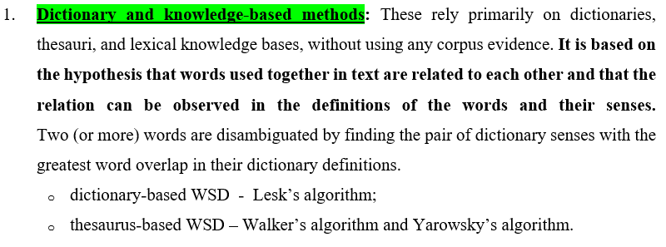
Methods for WSD - four conventional approaches to WSD:

Slide 16
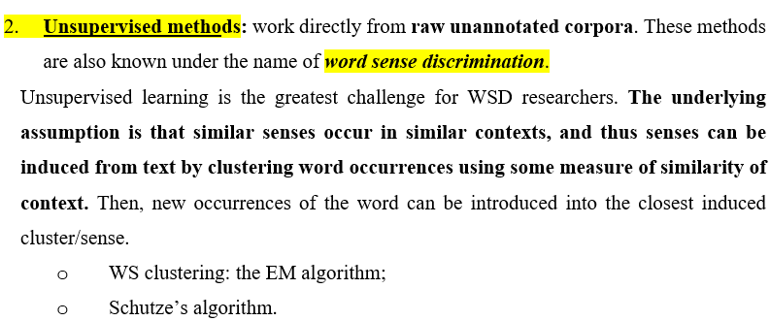
Methods for WSD - four conventional approaches

Slide 17
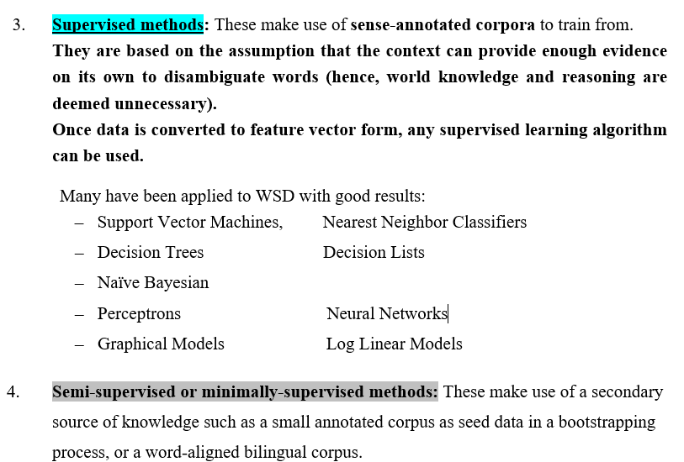
Methods for WSD - four conventional approaches to WSD:

Slide 18
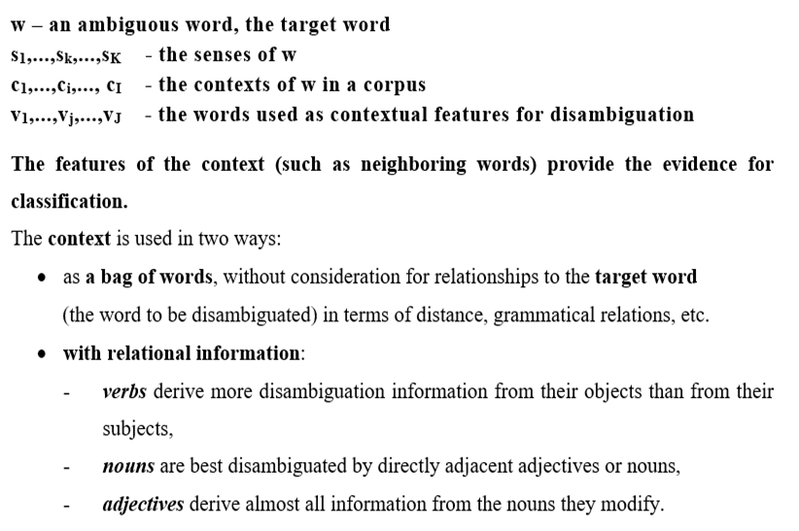
Notations

Slide 19
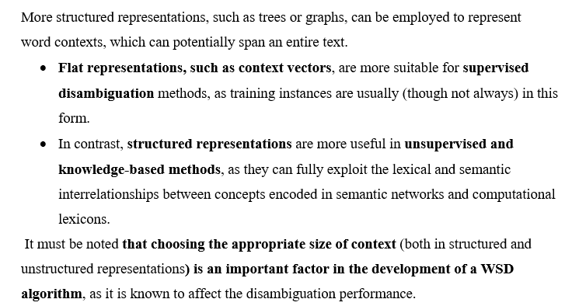
Context representation

Slide 20
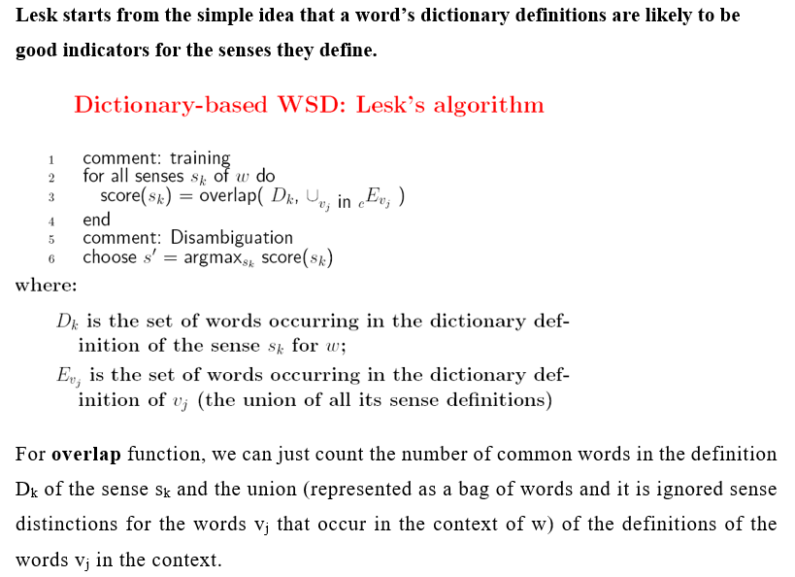
1. Dictionary-based methods

Slide 21
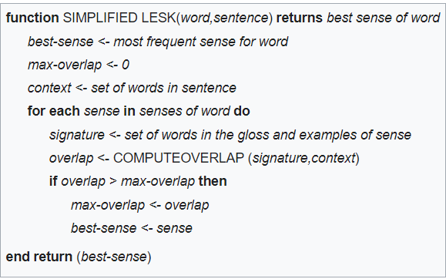
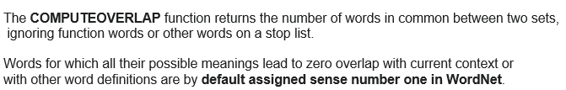
Simplified LESK algorithm

Slide 22
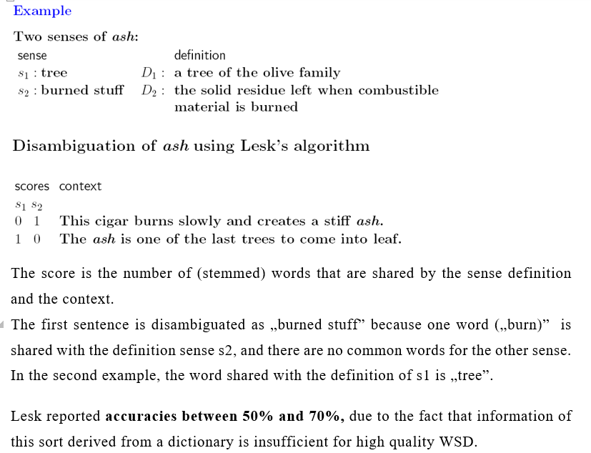

Slide 23
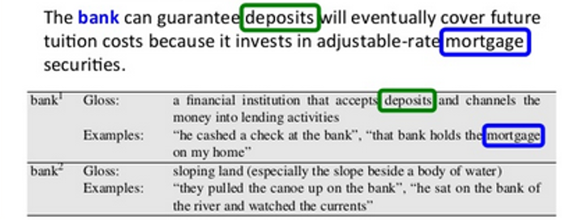
Example
There are 2 common words in the sentence (context) and (definition 1 and the corresponding examples) of bank.
The identified sense is bank¹.

Slide 24
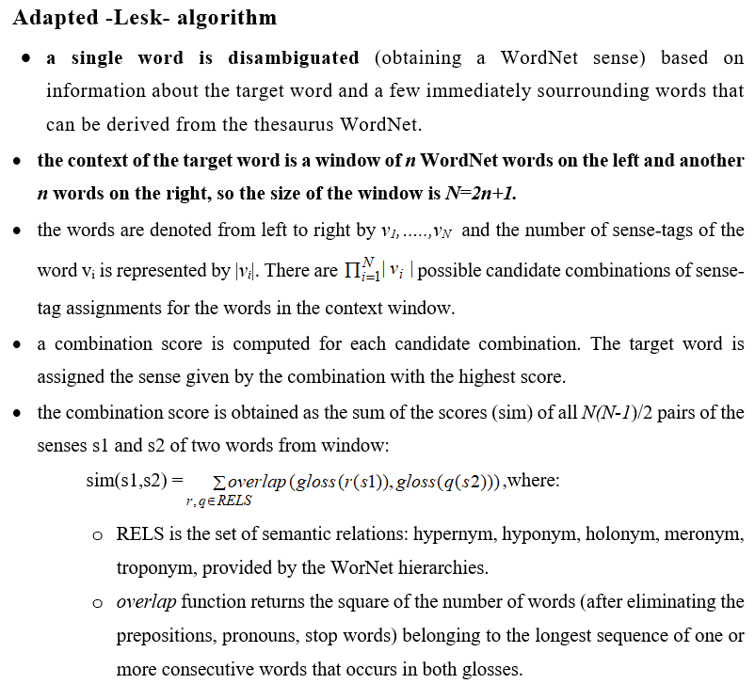

Slide 25
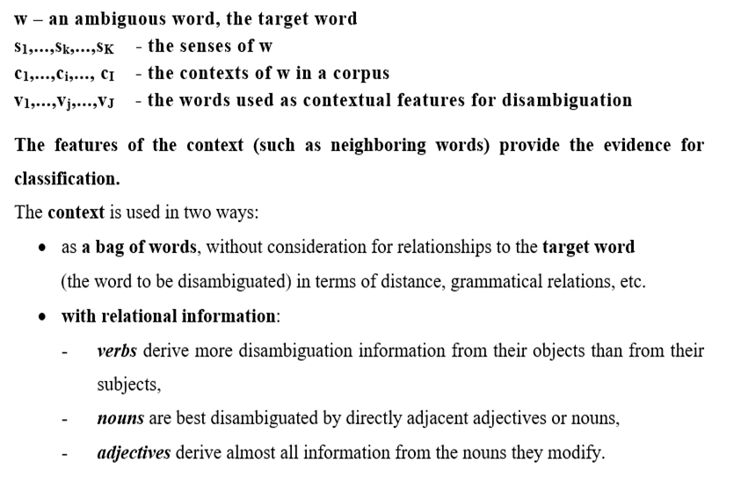
Notations

Slide 26
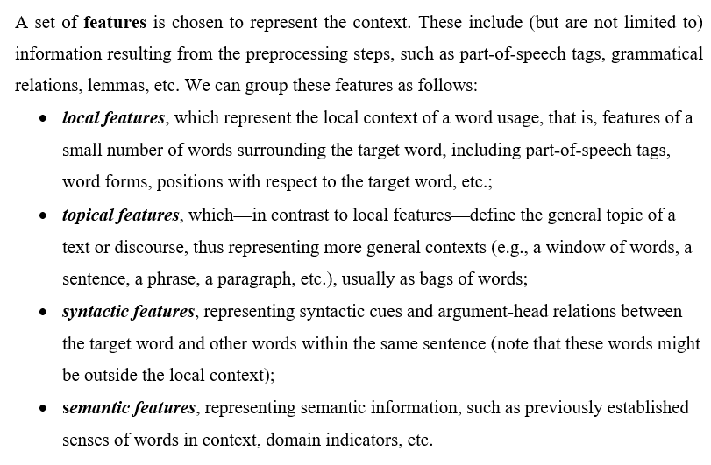
Features

Slide 27
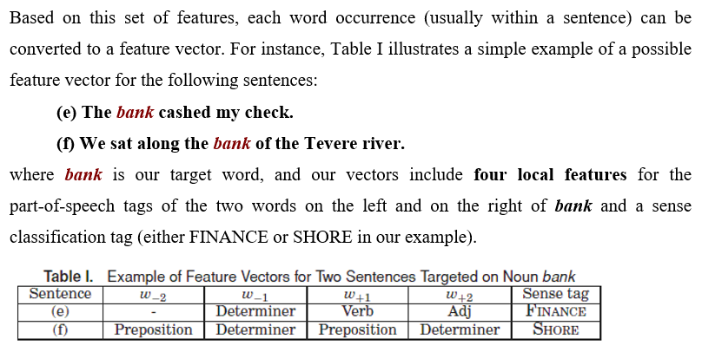

Slide 28
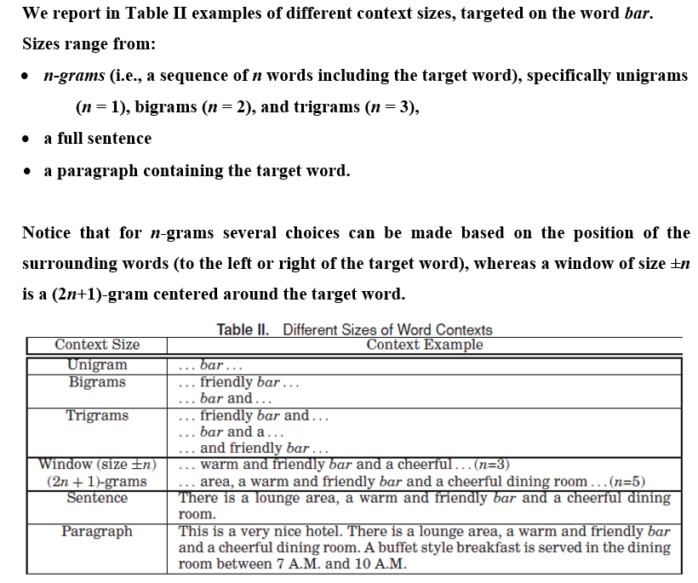

Slide 29
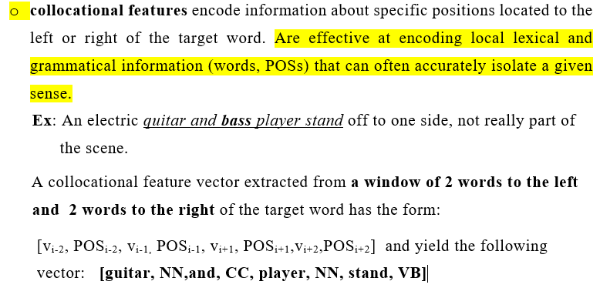
Contextual features - collocational features

Slide 30
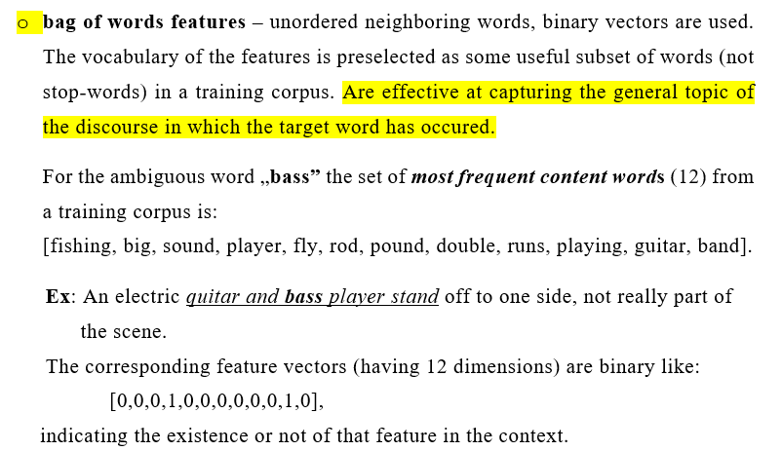
Contextual features – bag of words

Slide 31
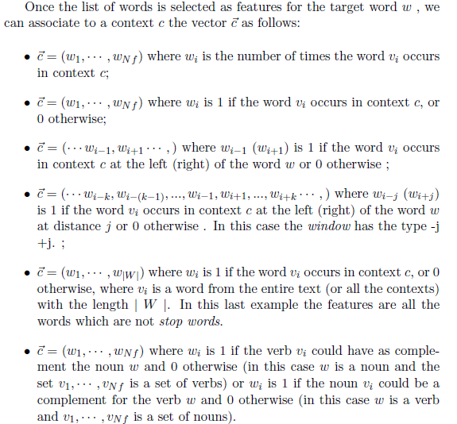
Most approaches of WSD use both types of features, either by joining them into one long vector or building a classifier for each feature type and combining them.

Slide 32
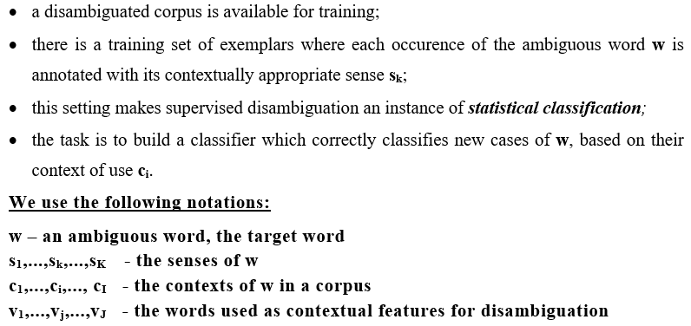
Supervised disambiguation

Slide 33
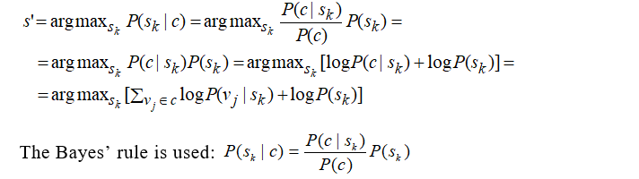
Supervised WSD through Naive Bayesian Classification

Slide 34
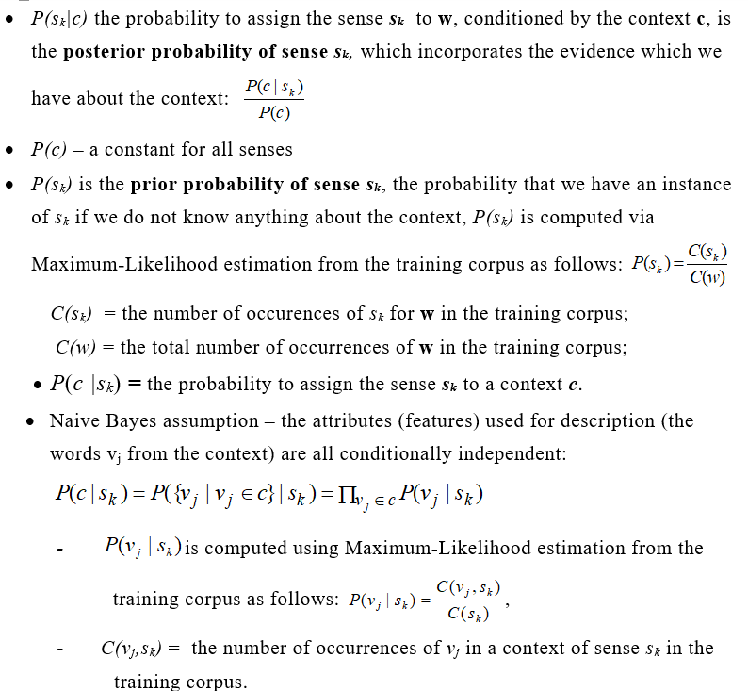
Naive Bayes Classification - Probabilities

Slide 35
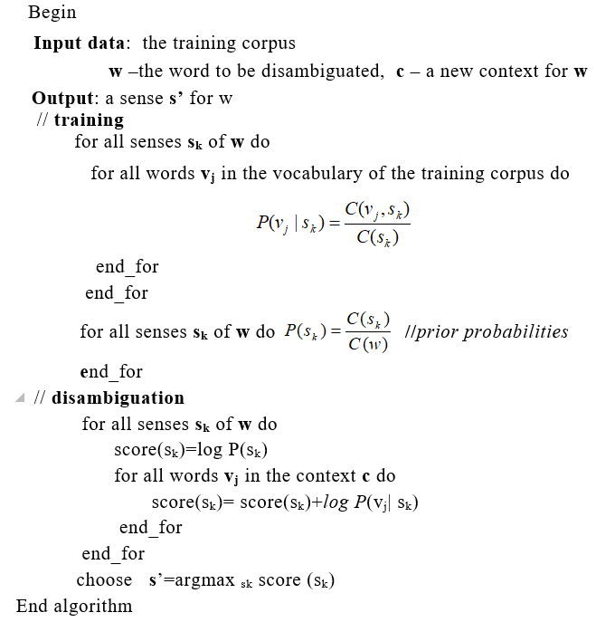
A Naive Bayse algorithm for WSD

Slide 36
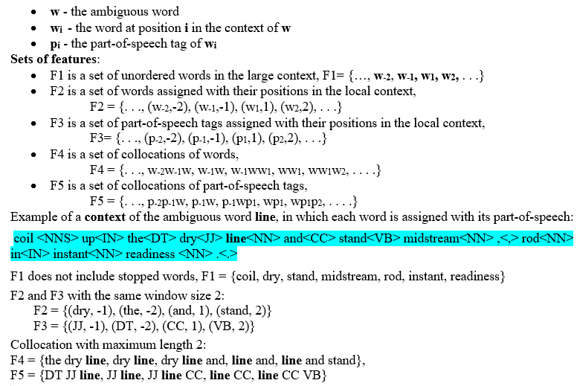
High WSD accuracy using Naive Bayesian classifier with rich features, Cuong Anh Le and Akira Shimazu

Slide 37
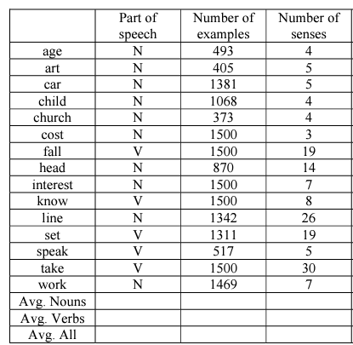
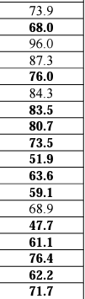
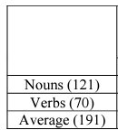
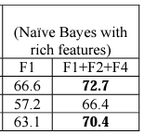
The Best Results (Accuracy) on the DSO corpus

Slide 38
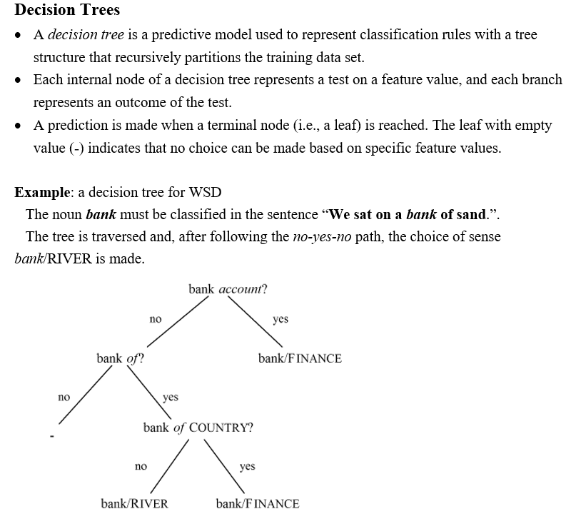

Slide 39
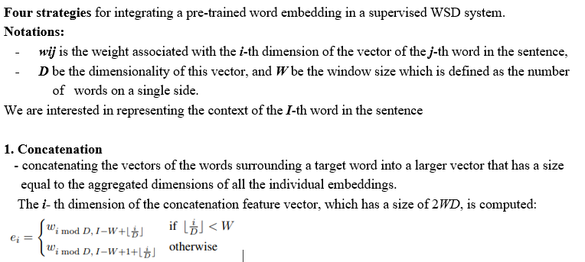
Static Word Embeddings as WSD features

Slide 40
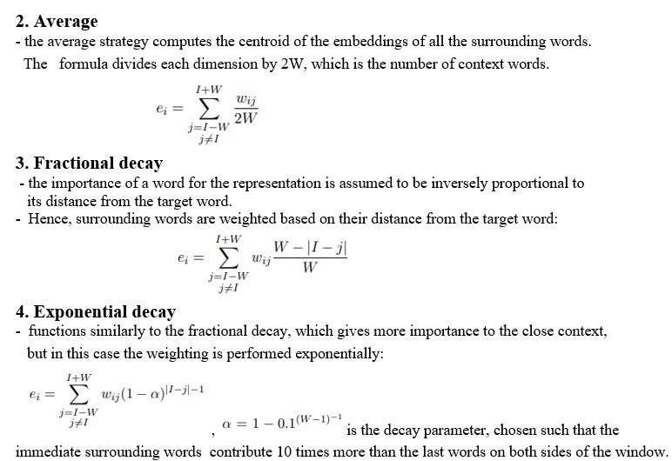
Static Word Embeddings as WSD features

Slide 41
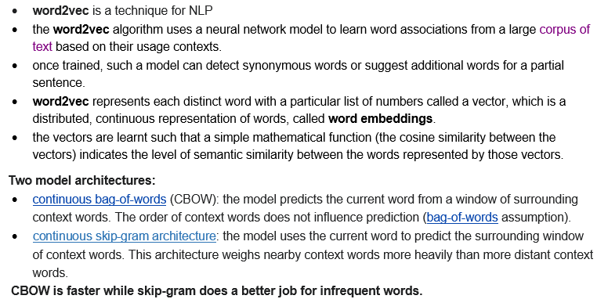
Word2Vec – Mikolov 2013

Slide 42
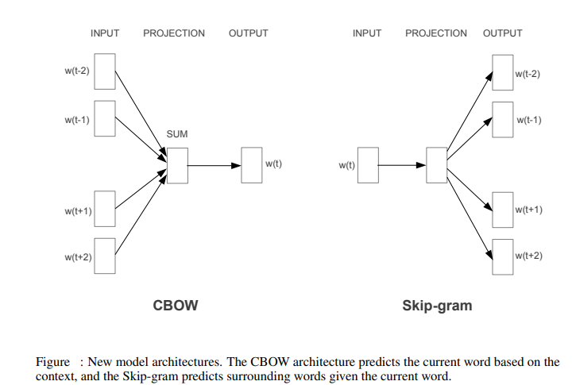
Word2Vec - architecture

Slide 43
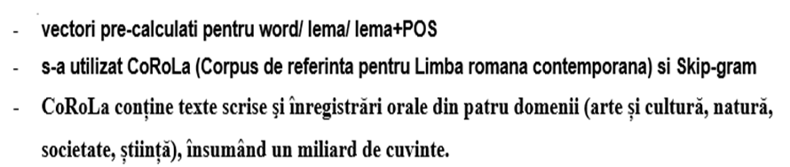
Pre-trained Word vectors for Romanian
https://corolaws.racai.ro/word_embeddings/

Slide 44

Contextualized Embeddings as WSD features

Slide 45





Slide 46



localized nearest neighbor word sense disambiguation

Slide 47

Best kNN models vs. most frequent sense (msf) and state of the art (F1%).

